Slide 1
Understanding Grades
Mr. Pores

Slide 2

The Power of Zero
The 4-point grading scale
How your grade is calculated with weighted categories based on standards
Class grading scale
How to earn the highest grade possible

Slide 3

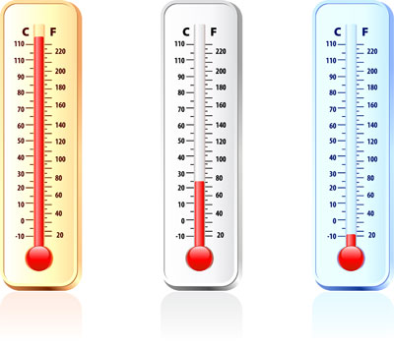
The Power of Zero
Pretend you have been hired to measure the average desert temperature for one week.
Each day, you go outside at noon, and using an accurate thermometer you record the temp.
However, on two days, the thermometer is malfunctioning.
Day 1: 99 degrees
Day 2: 101 degrees
Day 3: 100 degrees
Day 4: 0 degrees
Day 5: 102 degrees
Day 6: 98 degrees
Day 7: 0 degrees
What is the average?

Slide 4
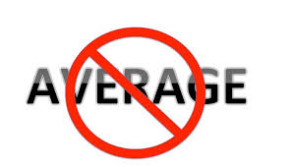
The Average 7-day temp. is…
Adding all 7 numbers up = 500
Dividing by 7 = 71 degrees
Is 71 degrees the true average temp for the week?
What are the implications?
How could this problem be resolved?

Slide 5
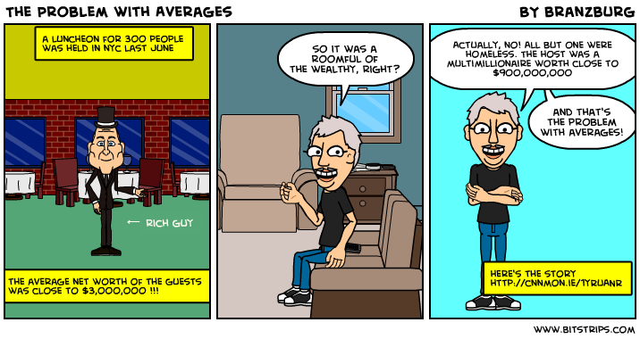
Why Averages Can Mislead

Slide 6
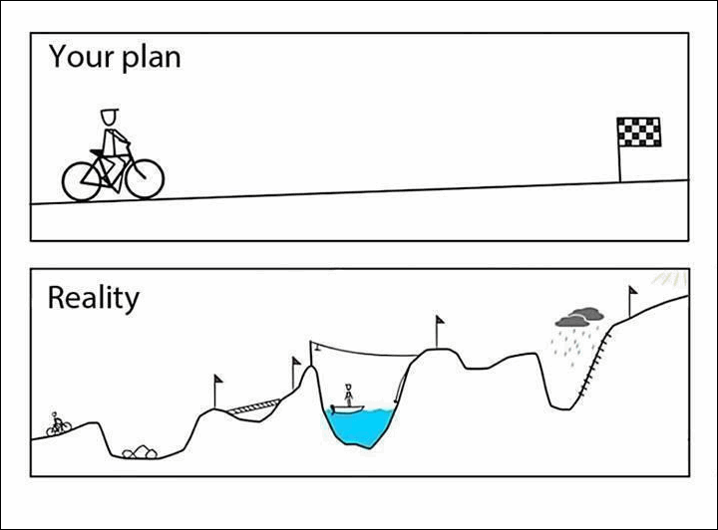
Why Averages Can Mislead

Slide 7
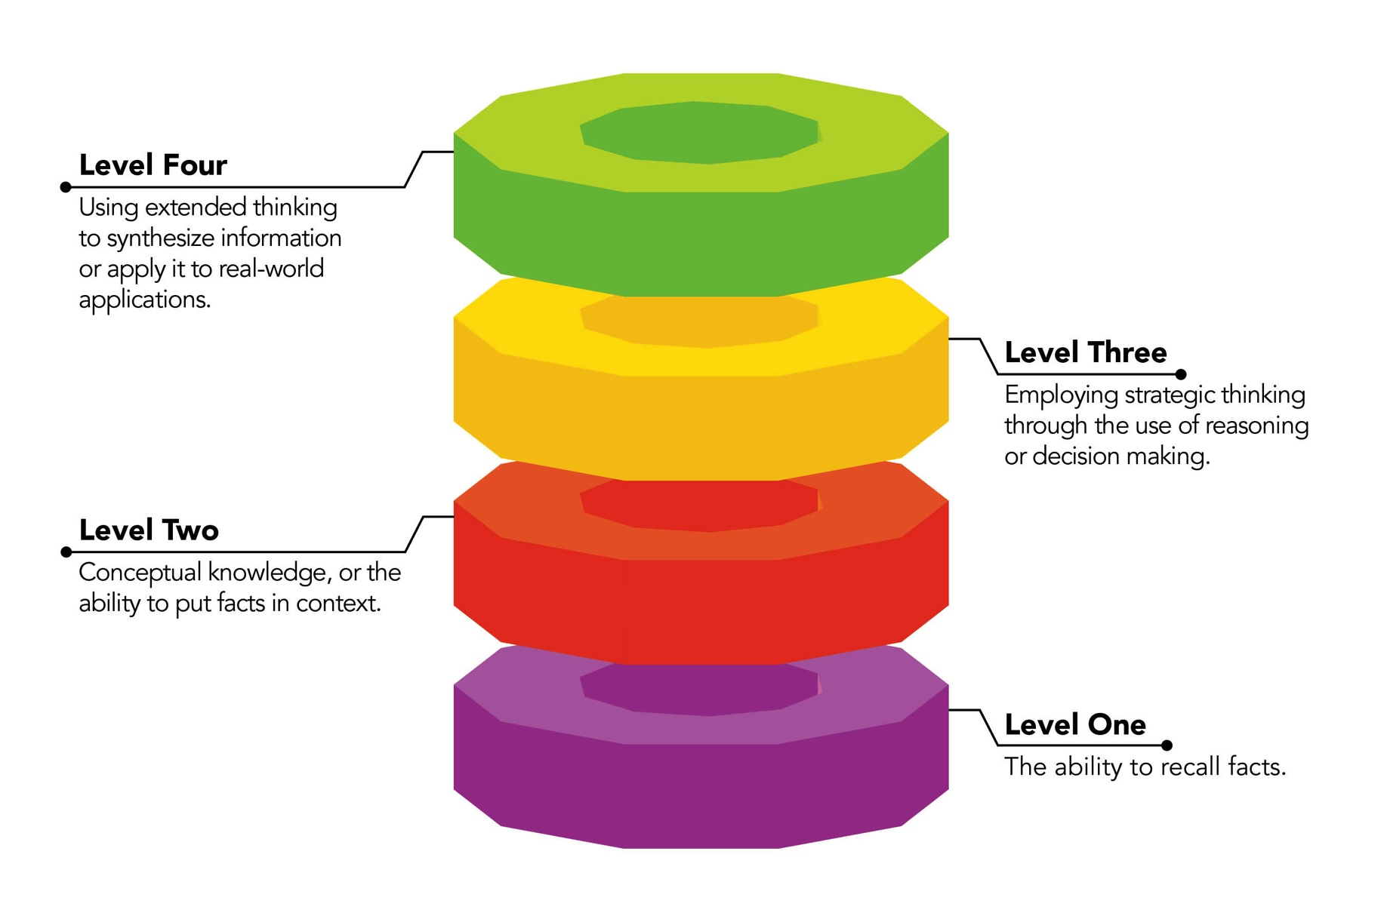
Your Graded Assignments

Slide 8
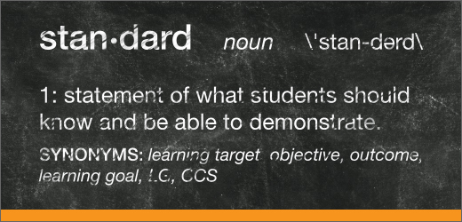
Standards-based grading avoids the pitfalls of averages by dividing points into categories that are based on discrete skills, not overall points earned, so your grade is based on true overall knowledge in each skill area
Your grade is divided into categories based on the Common Core State Standards
Most categories have at least 3 assignments each, ALL ASSIGNMENTS WORTH 4 POINTS, corresponding to the Depth of Knowledge levels, which also align with Smarter Balance Testing as well as your GPA

Slide 9

Standards-based grade book
Example:
  Reading Comprehension = 4 assignments, 16 points possible
  Analytical Paragraph = 3 assignments, 12 points possible
  Independent Writing = 8 assignments, 32 points possible
  Independent Reading = 1 assignment, 4 points possible
For your final class grade, each category is averaged individually, then all categories are averaged & converted to a percentage
Most standards-based categories are given equal weight, so here you would have each worth 25% of your grade, regardless of how many individual assignments are used
Let’s look at a sample…

Slide 10

Sample Standards-based grades:
  Divide the number of points earned by the number of assignments:
  Reading Comprehension = 14/ 16 points earned (avg. = 14/ 4 = 3.75)
  Analytical Paragraph = 10/ 12 points earned (avg. = 10/ 3 = 3.33)
  Independent Writing = 20/ 32 points earned (avg. = 20/ 8 = 2.5)
  Independent Reading = 0/ 4 points earned (avg. = 0/ 1 = 0)
  Add all category total avg.’s and divide by the number of categories:
  3.75 + 3.33 + 2.5 + 0 = 9.58
  9.58/ 4 = 2.4

Slide 11
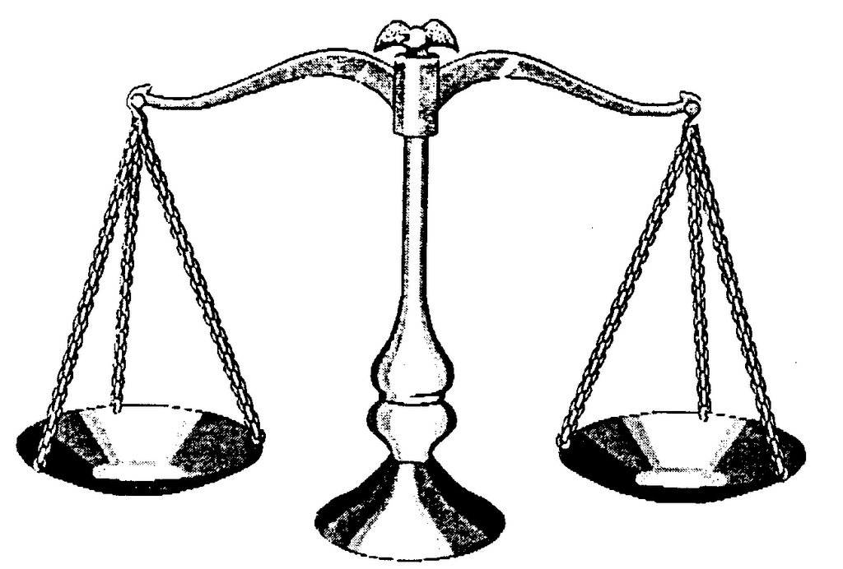
Class Grading Scale
Let’s look at the class grading scale and apply our example:
The class grading scale is based on the 4-point scale developed by Robert Marzano in Classroom Assessment and Grading that Works (2006), and proven to show the most accurate indication of your TRUE skill level based on the various mandated standards
4 = Advanced, beyond mastery (A = 87.5% - 100%)
3 = Proficient, shows mastery (B = 62.5% = 87.49%)
2 = Basic, shows some mastery (C = 37.5% - 62.49%)
1 = Approaching Basic with full effort
  Although a 1 will help indicate your need to redo an assignment, final grades of D are not awarded in this class, as they show your need to continue working towards a basic mastery
0 = 0% - 37.49%

Slide 12
Sample Grade
Our sample grade was calculated as a 2.4, so based on the class grading scale of:
A = 87.5% - 100%
B = 62.5% = 87.49%
C = 37.5% - 62.49%
F = 0% - 37.49%
Converting the sample grade to a percentage:
  2.4/ 4 = 0.6
  0.6 x 100 = 60%
  60% = C

Slide 13

Earning a Higher Grade
Here’s our sample again:
  Reading Comprehension = 14/ 16 points earned (avg. = 14/ 4 = 3.75)
  Analytical Paragraph = 10/ 12 points earned (avg. = 10/ 3 = 3.33)
  Independent Writing = 20/ 32 points earned (avg. = 20/ 8 = 2.5)
  Independent Reading = 0/ 4 points earned (avg. = 0/ 1 = 0)
If this student turns in all missing assignments, and revises all low scores, except Independent Reading, the final grade would be: 4 + 4 + 4 + 0 = 12, 12/ 4 = 3
The percentage of a 3/ 4 = 75%, which is a final grade of B

Slide 14
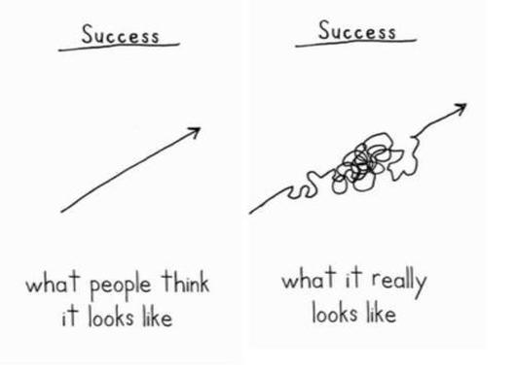
Success in Class

Slide 15

Implications
All categories count!
You can revise any assignments in this class, except for tests, quizzes, and finals
All revisions are due no later than 1 week after a progress report
Point-counting does not work
  Our sample student had a total of 64 points attempted, but half of those were in one category (Independent Writing)
    Some assignments occur more often than others, some are more challenging and take more time)
Extra Credit is not an option: Revision and Turning in Missing Assignments is the only way to earn a higher grade
All of the categories must be used to calculate your final grade
This method makes it easier to struggle without failure, while raising the standards for a truly advanced grade of A
I offer tutoring after school

Slide 16


  Marzano, Robert J. Classroom Assessment & Grading That Work. Alexandria, VA: Association for Supervision and Curriculum Development, 2006. Print.

